Slide 1
©️Naimul Islam Mehedi
Module 1: Introduction to Cybersecurity (Brief Overview)
Defining Cybersecurity: Threats, vulnerabilities, and assets.
The CIA Triad: Confidentiality, Integrity, Availability.
Types of Cyberattacks: Malware, phishing, DDoS, etc.
Introduction to Ethical Hacking: Definition, scope, and importance.
Legal and Ethical Considerations in Cybersecurity.
Different Roles in Cybersecurity: Security Analyst, Penetration Tester, Security Engineer, etc.

Slide 2
Defining Cybersecurity: Threats, vulnerabilities, and assets.

Slide 3
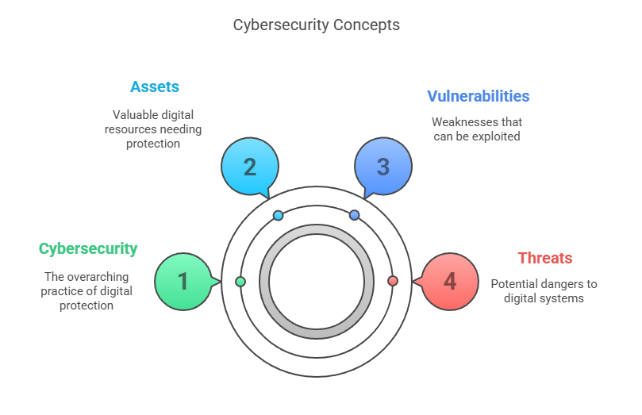
©️Naimul Islam Mehedi

Slide 4
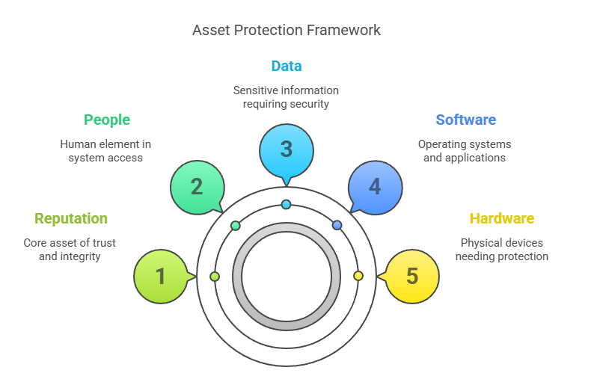
©️Naimul Islam Mehedi

Slide 5
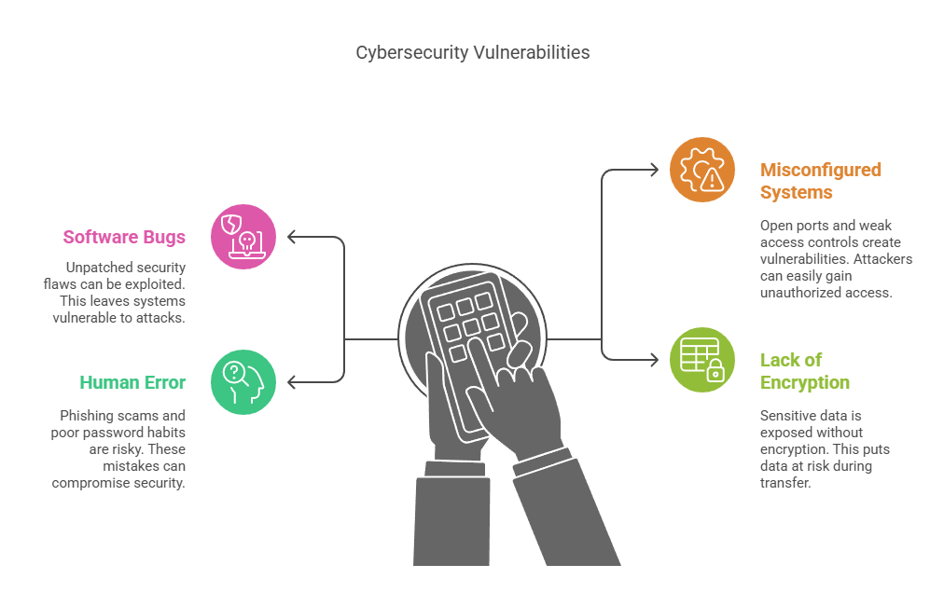
©️Naimul Islam Mehedi

Slide 6
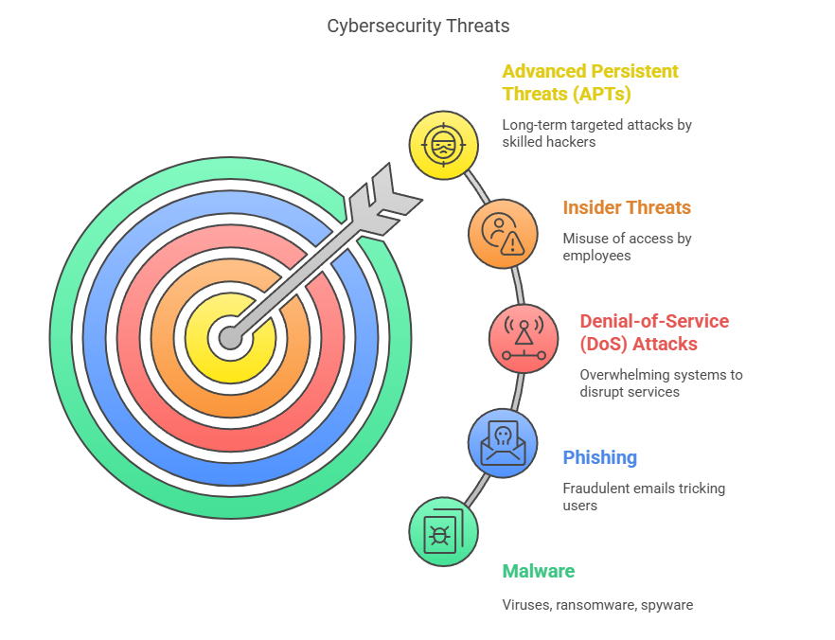
©️Naimul Islam Mehedi

Slide 7
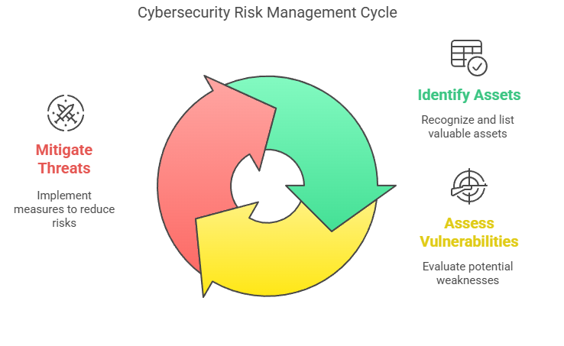
Threat actors (hackers, cybercriminals) look for vulnerabilities to exploit in assets.
Effective cybersecurity involves risk management: identifying assets, assessing vulnerabilities, and mitigating threats.
©️Naimul Islam Mehedi

Slide 8
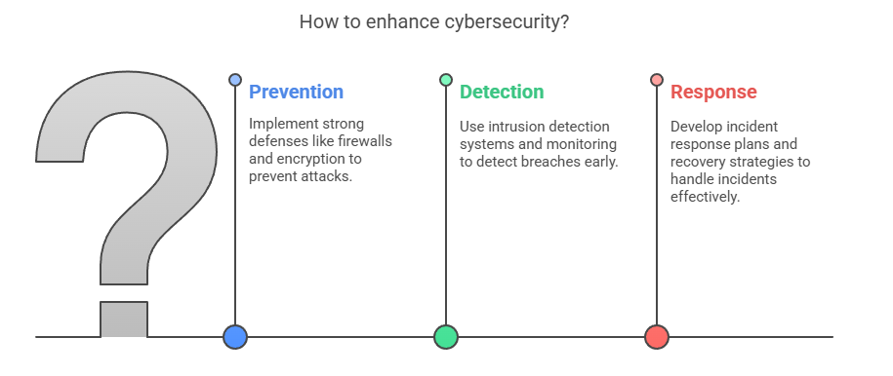
Key Goal of Cybersecurity
To protect confidentiality, integrity, and availability (CIA Triad) of assets by:
Preventing attacks through strong defenses (firewalls, encryption).
Detecting breaches early (intrusion detection systems, monitoring).
Responding to incidents (incident response plans, recovery strategies).
©️Naimul Islam Mehedi

